Slide 1
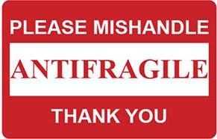
Antifragility - The code that feeds on chaos
Florin Marius Popescu Software Engineer @ Froala

Slide 2

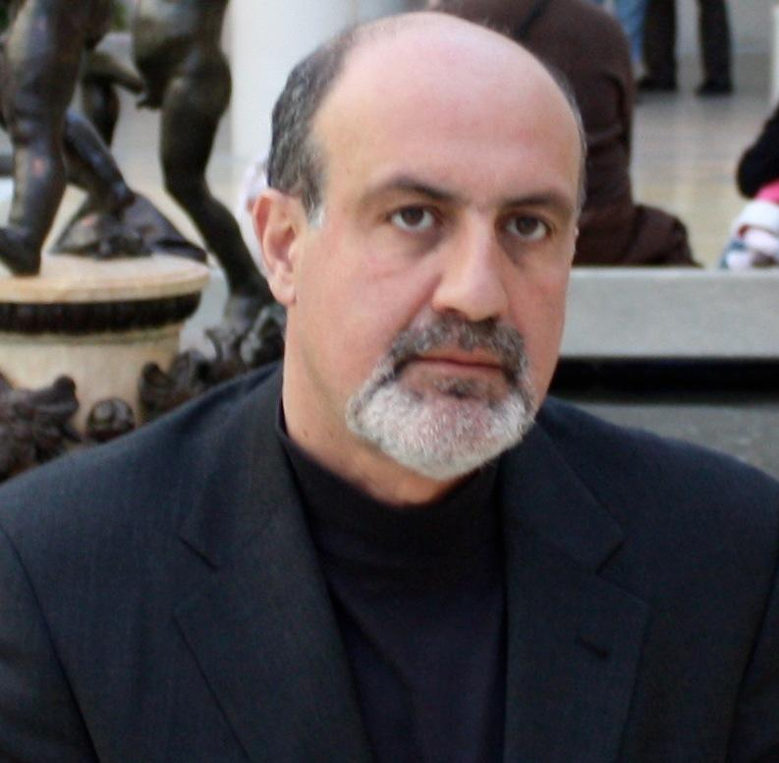
Author: Nassim Nicholas Taleb

Slide 3

Motivation

Slide 4



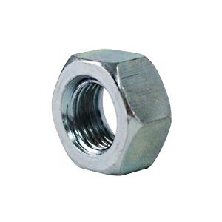
What is antifragility?
fragile
robust
agile
antifragile

Slide 5

Fragile/Robust
Build wheels.
Build engine.
Build … oups out of business.

Slide 6
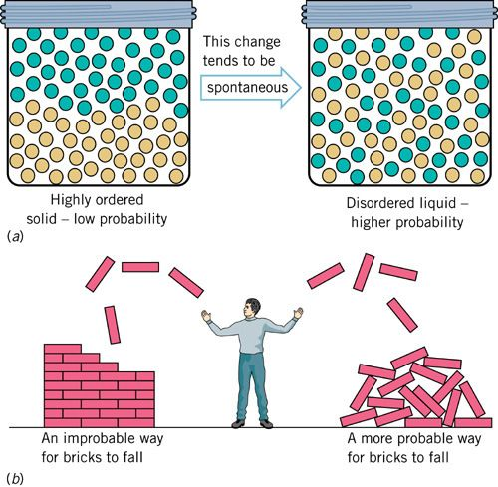
Second law of thermodynamics

Slide 7

Agile
Build a roller blade.
Build a bike.
Build a car.

Slide 8
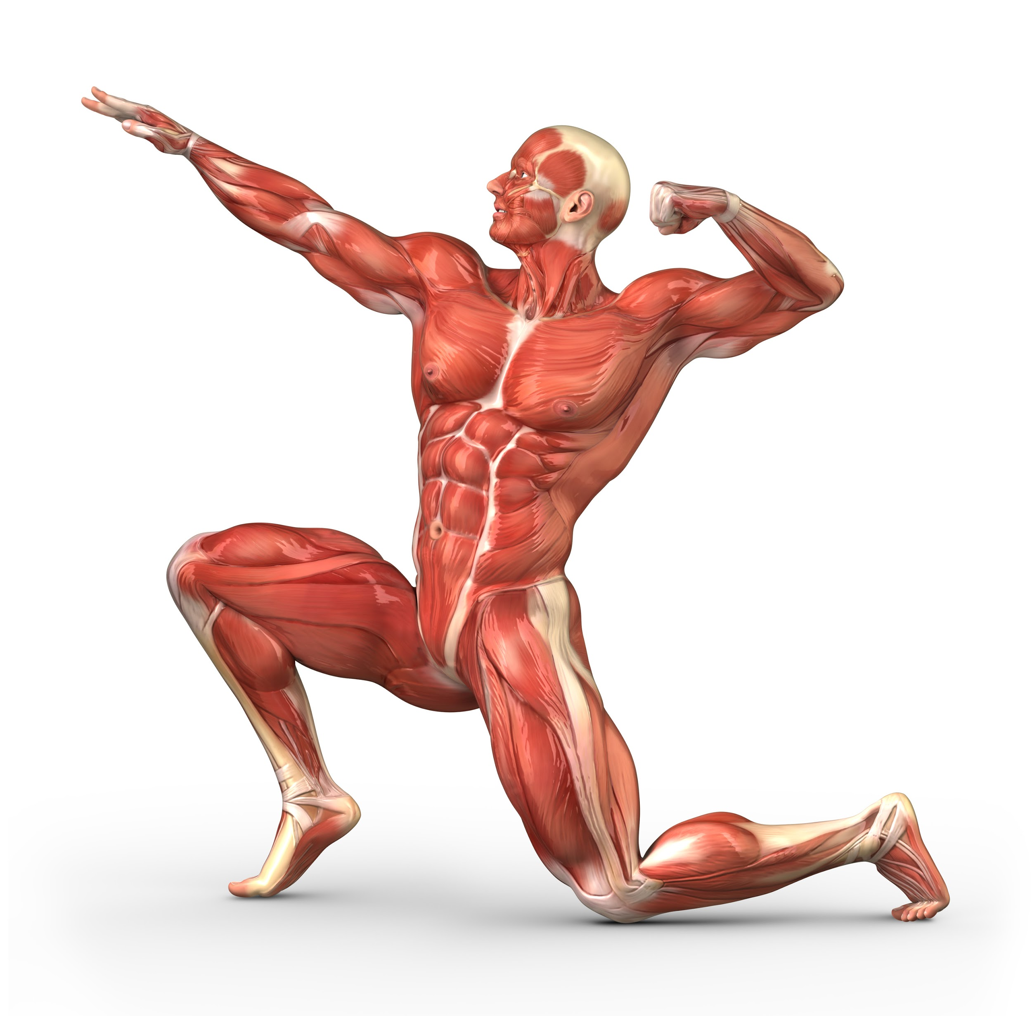


Antifragile
Build a scooter.
Scooter delivery.
Air conditioning.
Space travel.

Slide 9
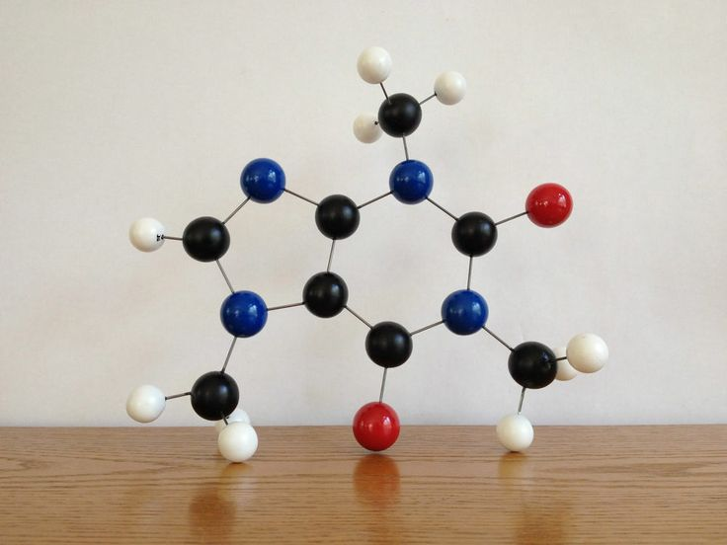
Agile vs Antifragile

Slide 10
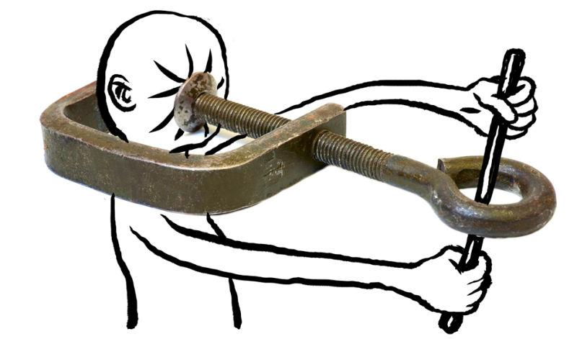
Why you would die instantly?

Slide 11
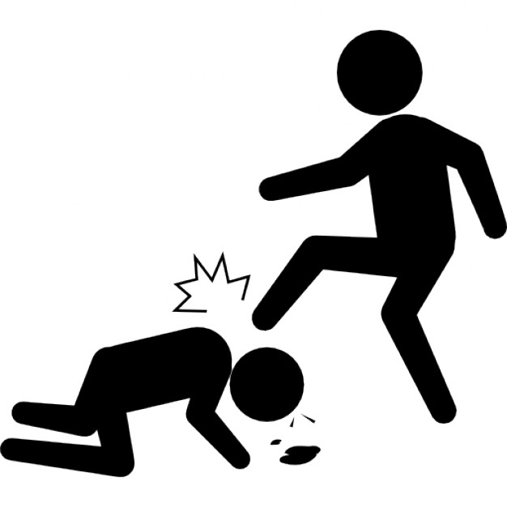
Feed the antifragile.

Slide 12
Purpose of life.
Self Actualization
Esteem
Relationships
Safety
Physiological needs
HAZARD

Slide 13

Fruits want you dead. Poisoning

Slide 14

Skin in the game

Slide 15

Redundancy is good, optimum not.

Slide 16
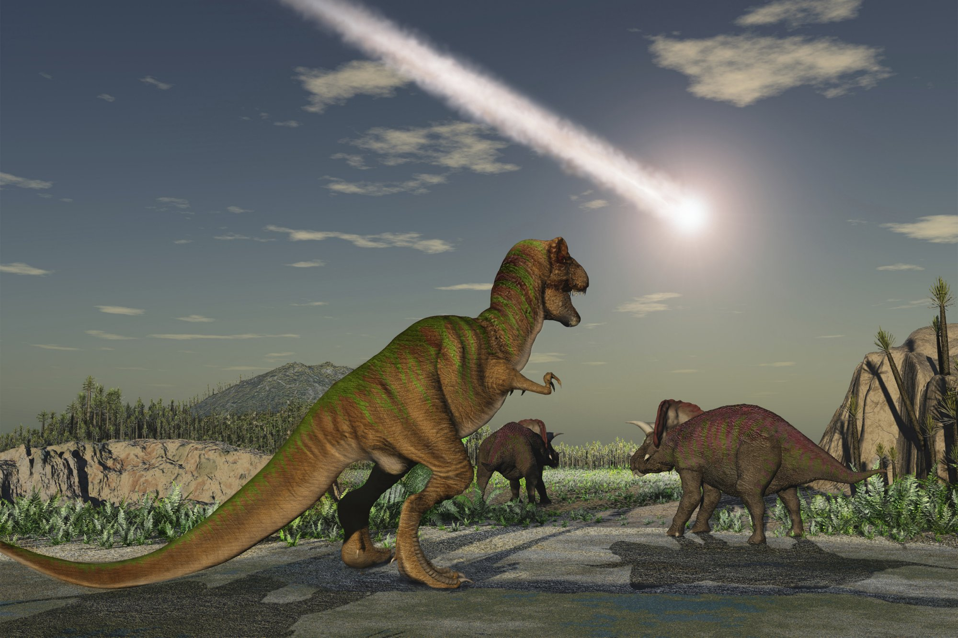
Big is not good.

Slide 17

Keep it local.

Slide 18
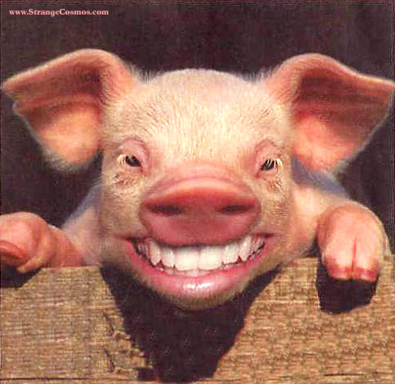
Statistics: Pricoche the happy pig.

Slide 19
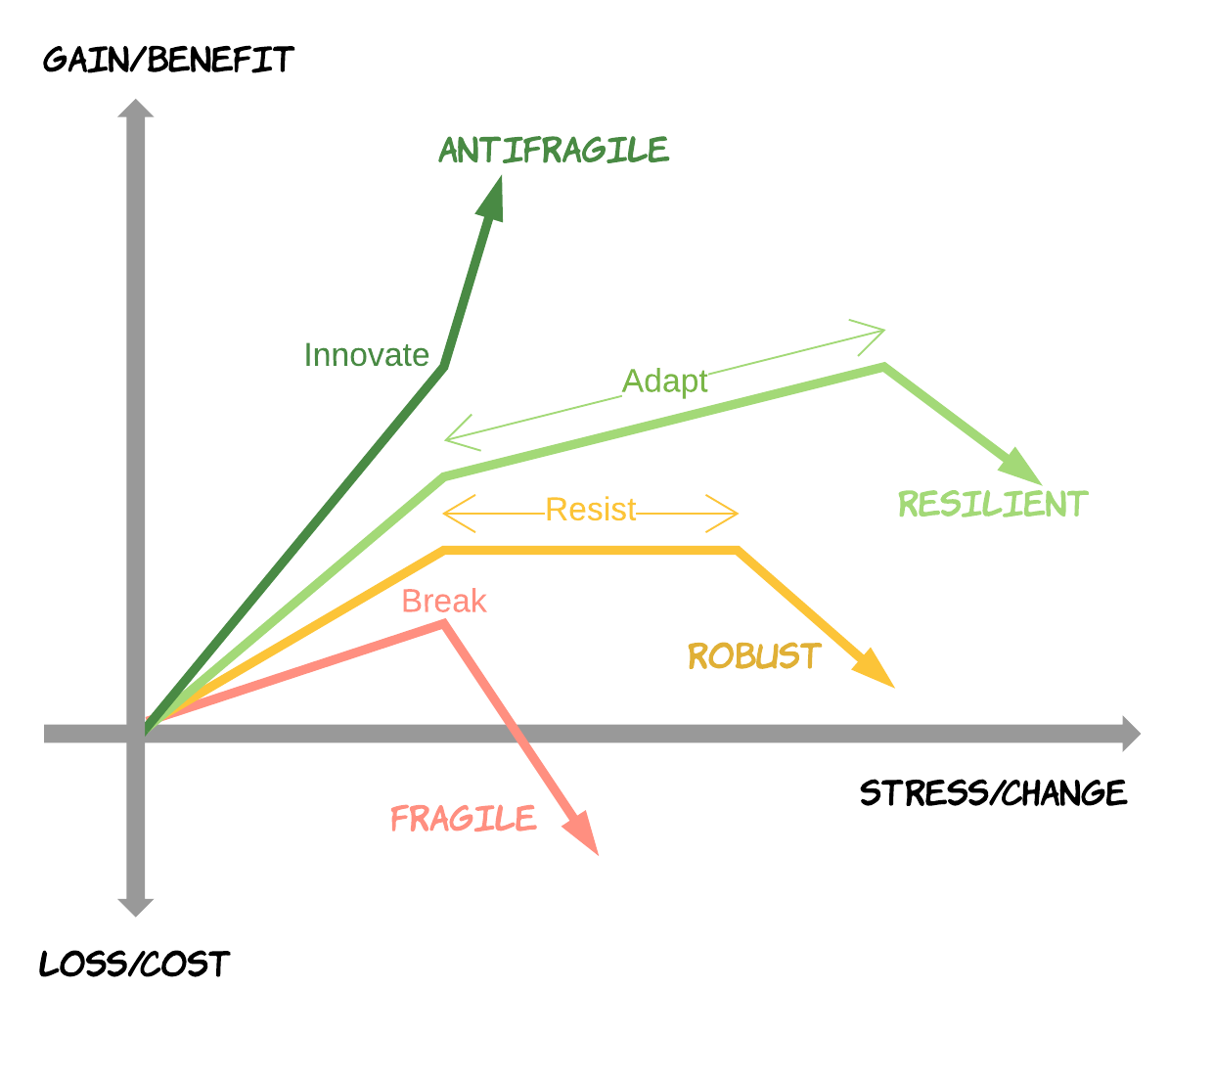
Startups

Slide 20


System dependent

Slide 21


Antifragile programming
the code

Slide 22

Agile vs Antifragile

Slide 23

Patch

Slide 24
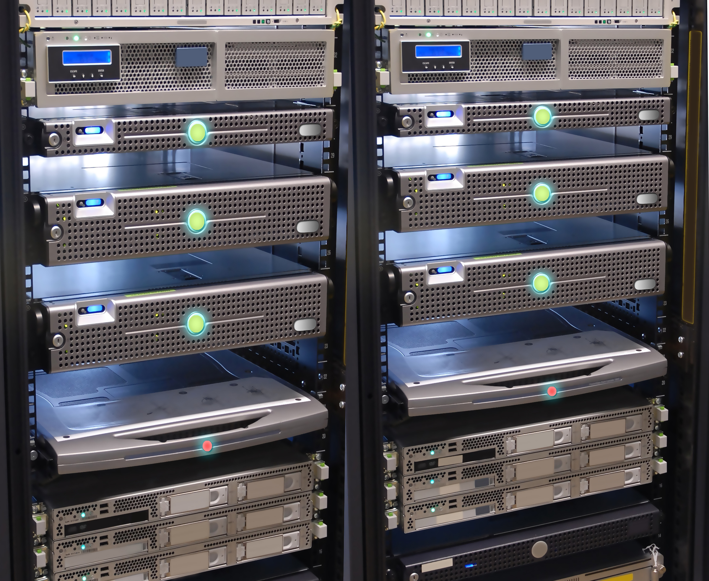
Redundancy

Slide 25

Poison

Slide 26



10x, Questions and Additions.

